Slide 1


NGC 3344’s Stellar Population
Eyan Weissbluth
Mentors: Dr. Sanchayeeta Borthakur, Mansi Padave
Funded through the NASA Space Grant Program

Slide 2
Stellar and Galactic Evolution
Galaxy evolution is dependent on stellar populations
How stars evolve gives insights into a galaxy’s populations
Where certain types of populations are also gives information

Slide 3
Extended Ultraviolet Disk Galaxies
These galaxies experience star formation in outermost regions
Found out from UV emissions from HII regions
Surveys show that 30% of all spiral galaxies experience this phenomenon

Slide 4
NGC 3344
Barred spiral galaxy located 22.5Mly from Earth
Approximately half the size of the Milky Way
Subject of a study that provided evidence of inside-out disk growth

Slide 5
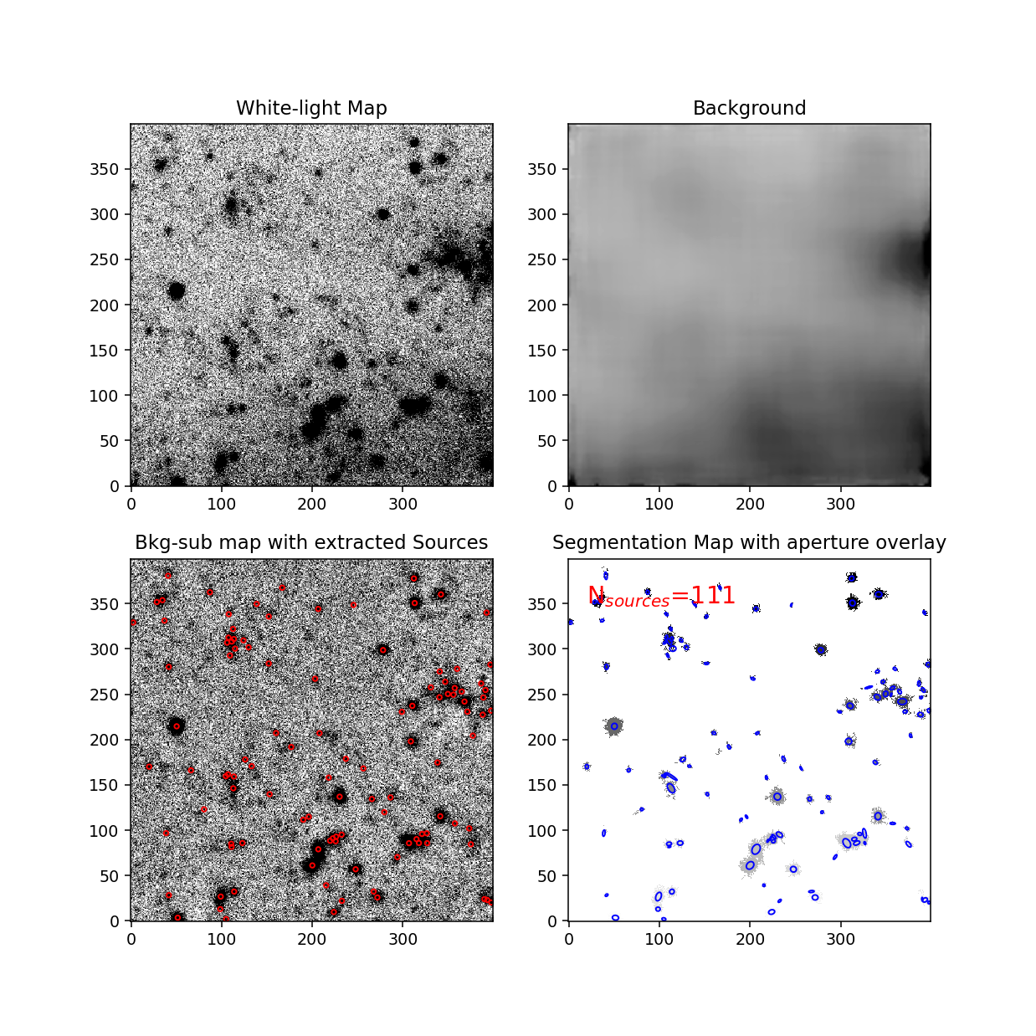
Regions of NGC 3344
Image data from the LBT was used to create white light map
That map was sectioned off into 30 different piece for accurate detection
Python-based package used to extract sources

Slide 6
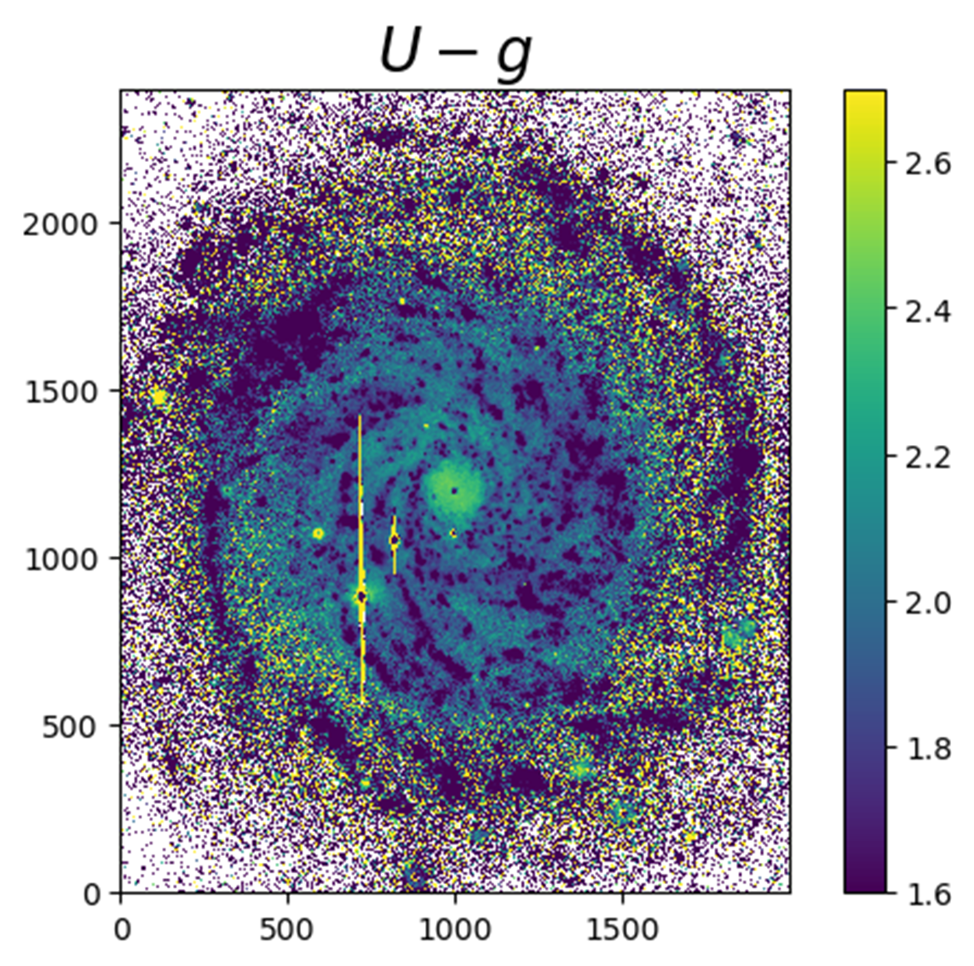
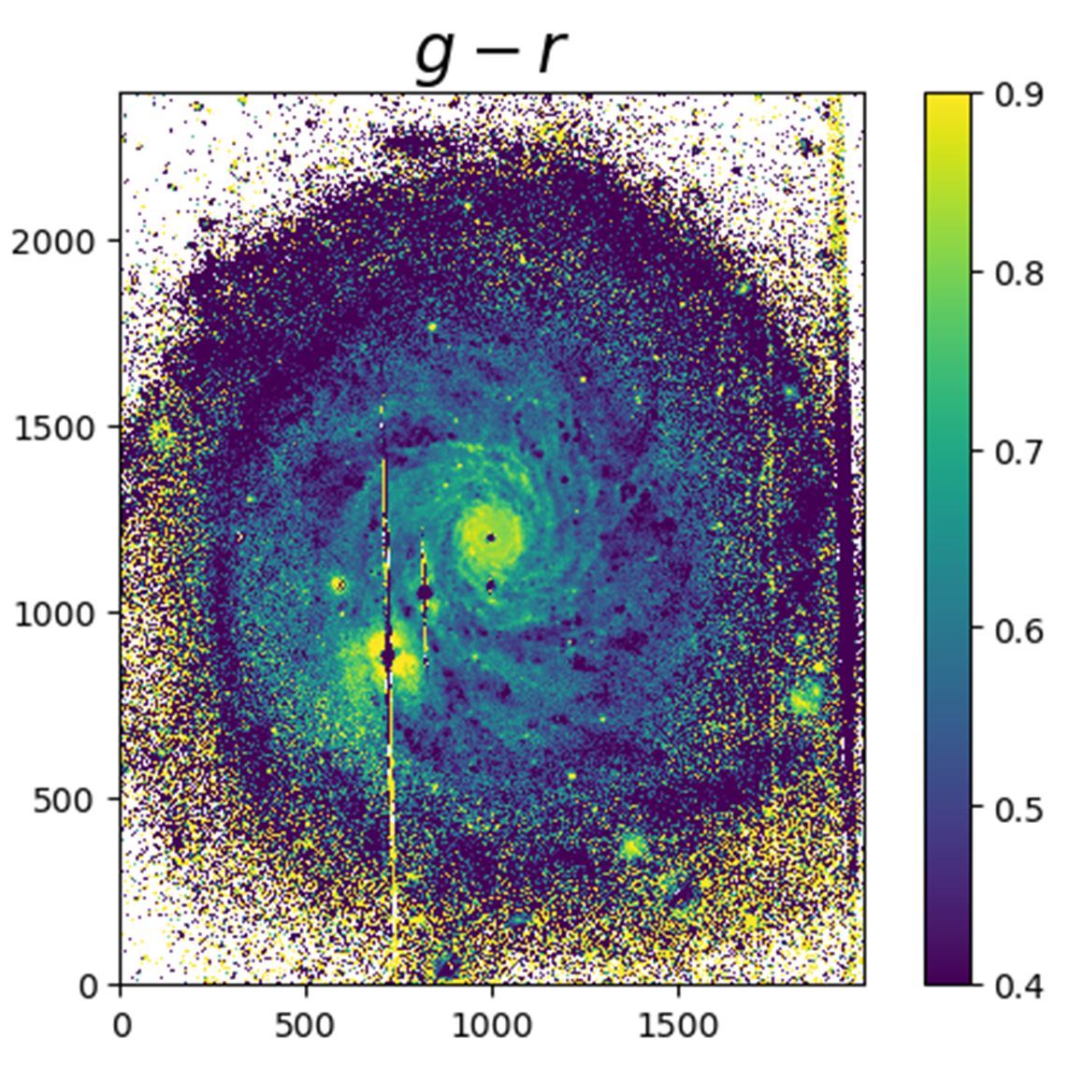
Color Maps for NGC 3344

Slide 7
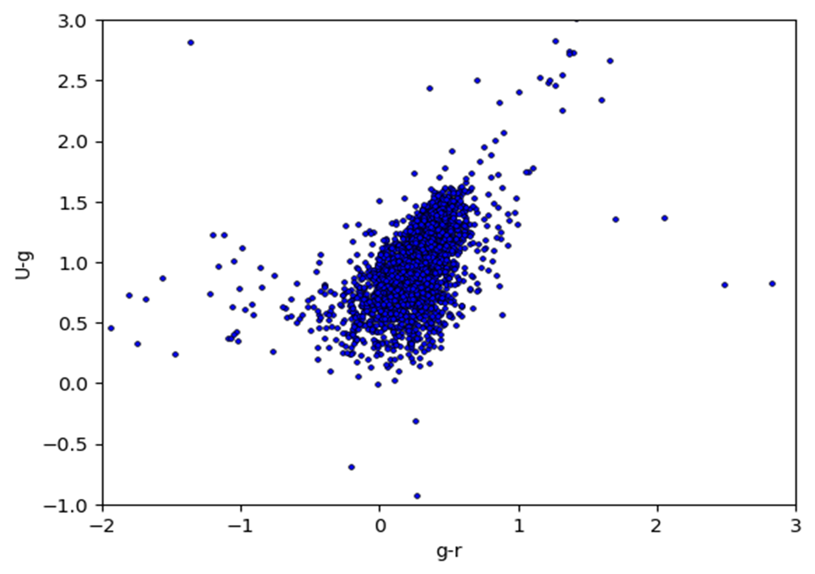
Color-Color Diagram for regions
Colors are difference in brightness through different light filters.
Plot also indicates younger stars

Slide 8
Conclusions
These observations point towards the inside-out disk growth theory.
More research is required for specifics on formation rates in NGC 3344

Slide 9
Acknowledgements
Padave, M., Borthakur, S., Gim, H. B., Jansen, R. A., Thilker, D., Heckman, T., Kennicutt, R. C., Momjian, E., & Fox, A. J. (2021). DIISC-II: Unveiling the connections between star formation and interstellar medium in the extended ultraviolet disk of NGC 3344.

